Slide 1

Notes:
Please customise, add or remove slides and information to reflect how the Summer Reading Challenge is run locally.

Slide 2


What is the Summer Reading Challenge?
The Summer Reading Challenge is a reading program where children are tasked with reading 6 books over the summer holiday, winning prizes along the way.

Slide 3
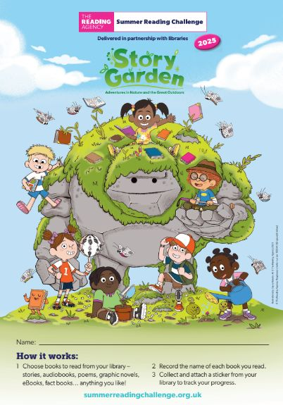

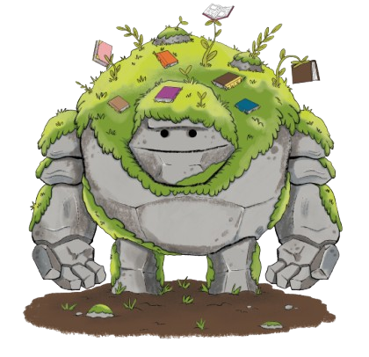
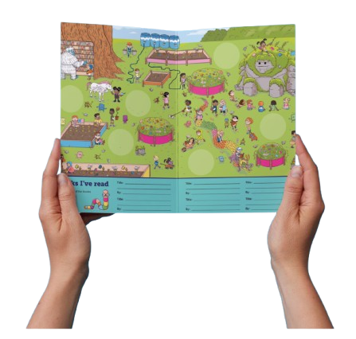
Take on the Challenge!
Go to your library this summer to sign up and get your Story Garden sticker booklet…
Read ANYTHING you like
Collect stickers from your library and add them to the magical garden as you read more
Rewards for meeting your goal!
Notes:
To join the reading challenge find a member of staff or a Summer Reading Challenge volunteer and ask to join the Challenge, Remember you must be a member of the Library to take part in the Challenge. To join the library all you need to do is fill in form which can be collected from your local library or accessed online, have a parent or guardian fill this in with your details and then you can get your very own library card. It is Free to join the library and the reading challenge.
Next choose anything you like to read (can be a book, comic, magazine, audiobook, eBook, fact book etc.) and collect rewards for your reading.

Slide 4
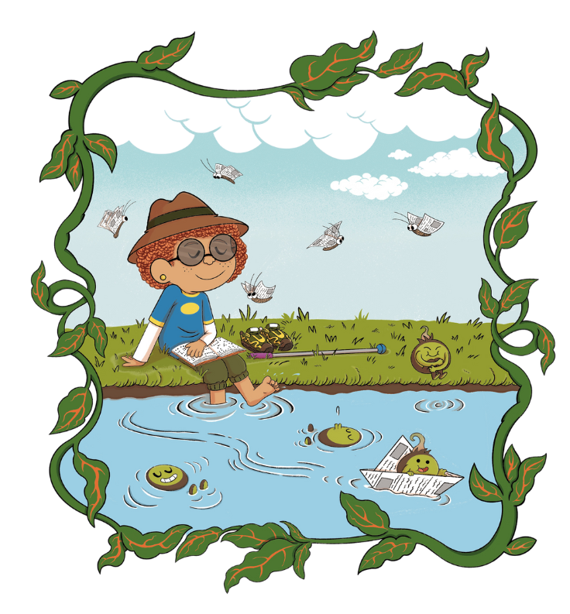
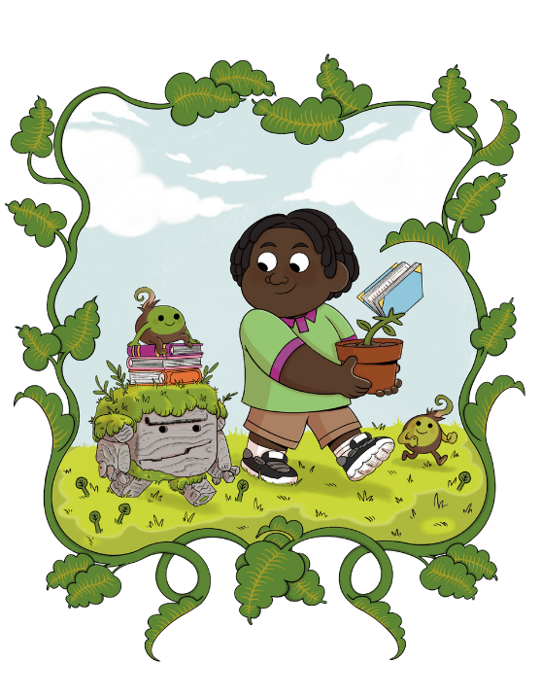
Magical Nature Theme
Notes:
This year’s Challenge is called Story Garden, and it’s all about nature, exploring the outdoors, exploring magical spaces, storytelling - and reading! Your library can help you find new books to enjoy and we’ll be hosting lots of events and activities connected to nature and wildlife, that will be sure to inspire your next story adventure.
Explore the magical connection between nature and reading with our Story Garden characters! You'll meet them inside your collector’s sticker booklet and spot amazing fantastical creatures and plants dotted around the garden – all illustrated by this year’s special guest award-winning illustrator, Dapo Adeola. Come along to your library for sign up day to collect your own sticker booklet and start reading!

Slide 5
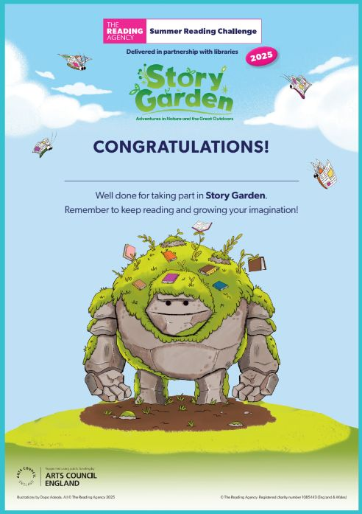
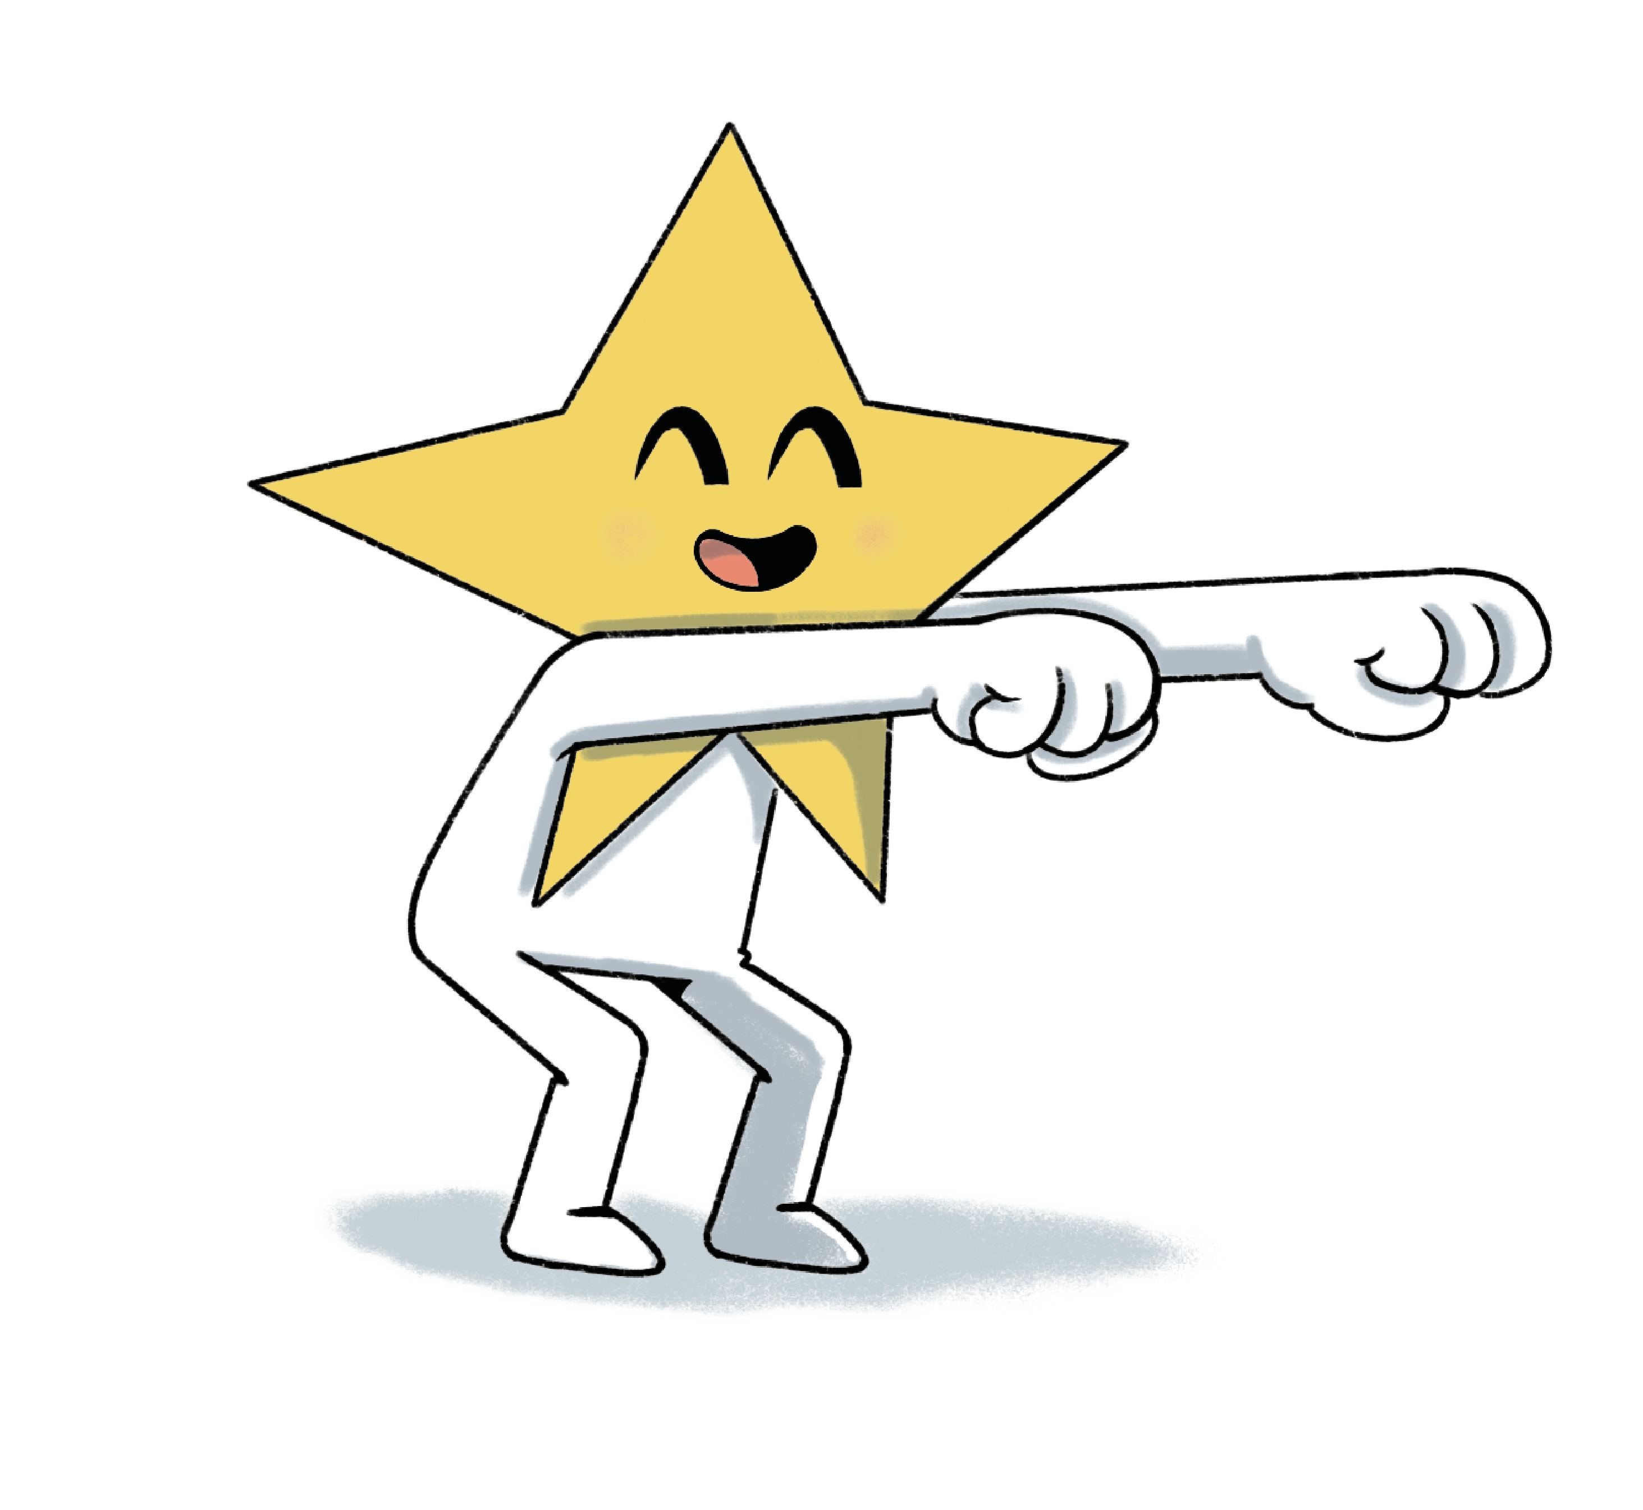
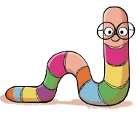
Once joining the challenge, you will receive a Bug sticker and a rainbow pencil.
After reading 2 books you will receive your first set of stickers and collector's wallet.
After reading 4 books you will receive your second set of stickers and a bookmark.
After reading 6 books you will receive your last set of stickers, medal and certificate and a goody bag!

Slide 6

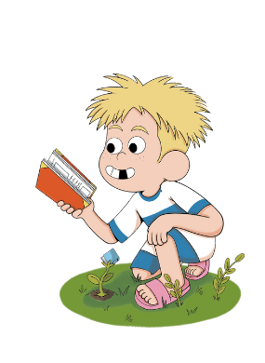
When does it start?
Saturday 5th July 2025
Your nearest Library is:
Darlaston Community Library
Opening times:
Tuesday to Friday…..8.30am – 6.00pm
Saturday.....9.00am – 5.00pm
Sunday & Monday…..CLOSED

Slide 7
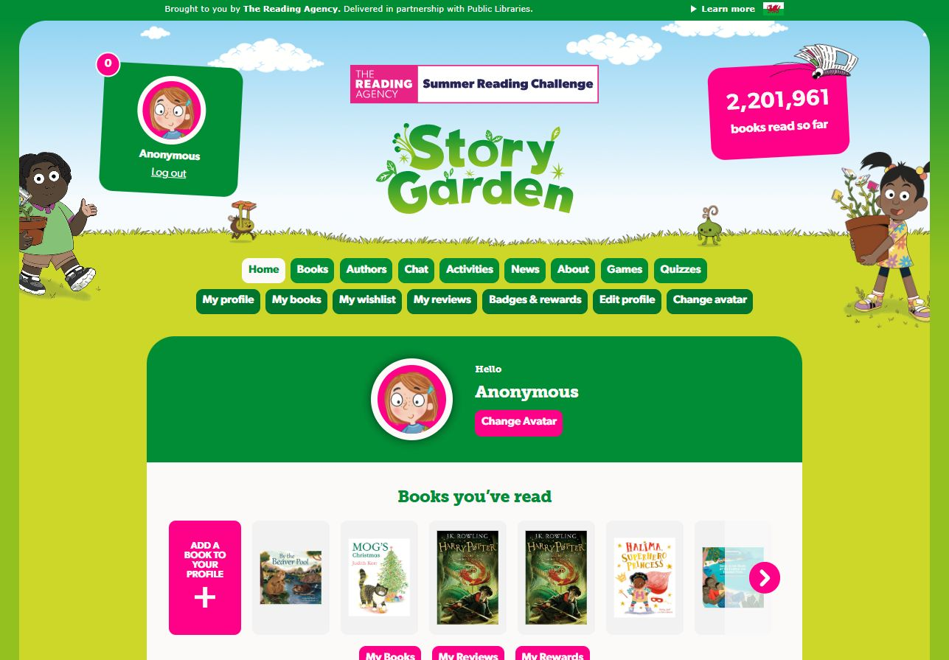

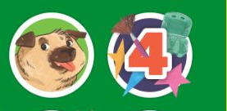

You can take part online!
✰ Set your own summer reading goal
✰ Rate and review your books to unlock badges
✰ Play games and enter competitions
✰ Use the Book Sorter to find books recommended by other children
summerreadingchallenge.org.uk
Notes:
The fun continues at home too! Visit the Summer Reading Challenge website to play games, review your latest reads and enter competitions.
You can share your favourite books with other children taking part in the Challenge and unlock extra rewards for your reading and reviewing!

Slide 8
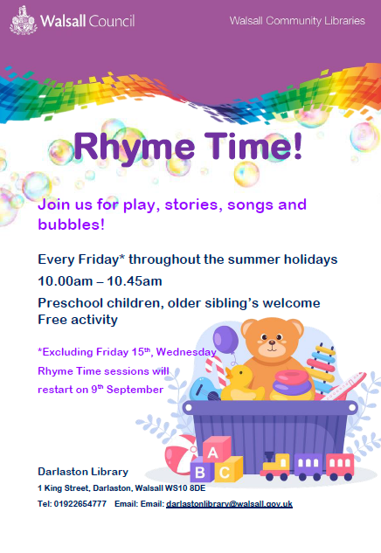
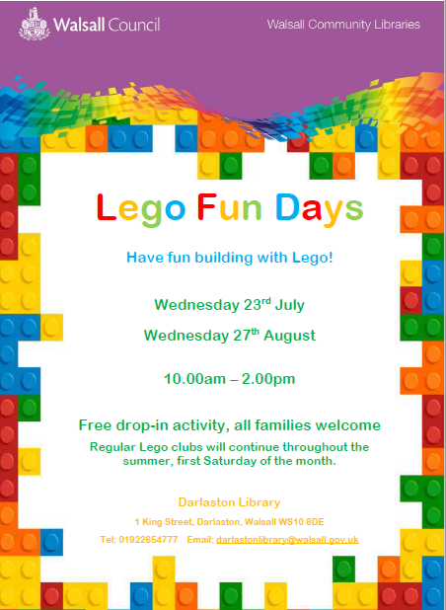
Fun events & activities coming up
Notes:
There will be lots of dun activities going on in your local library this summer holidays. To see what your local library has to offer pop into your local library or check on our Facebook page under love Walsall libraries.

Slide 9
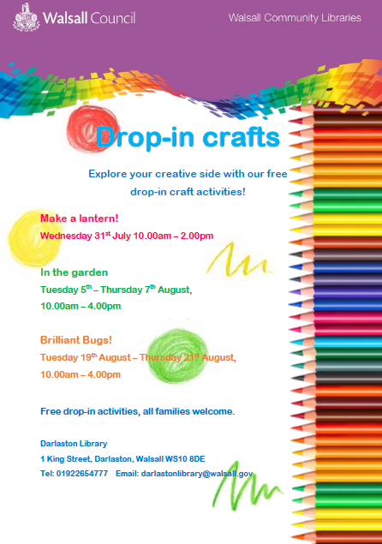
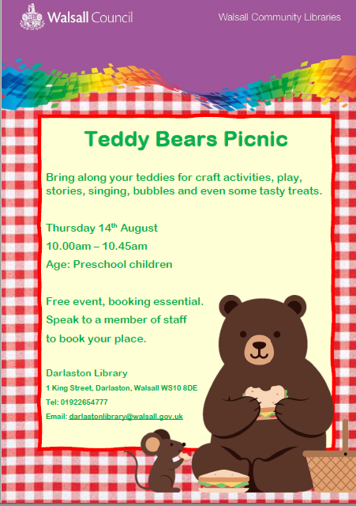
Fun events & activities coming up
Notes:
There will be lots of dun activities going on in your local library this summer holidays. To see what your local library has to offer pop into your local ;library or check on our Facebook page under love Walsall libraries

Slide 10

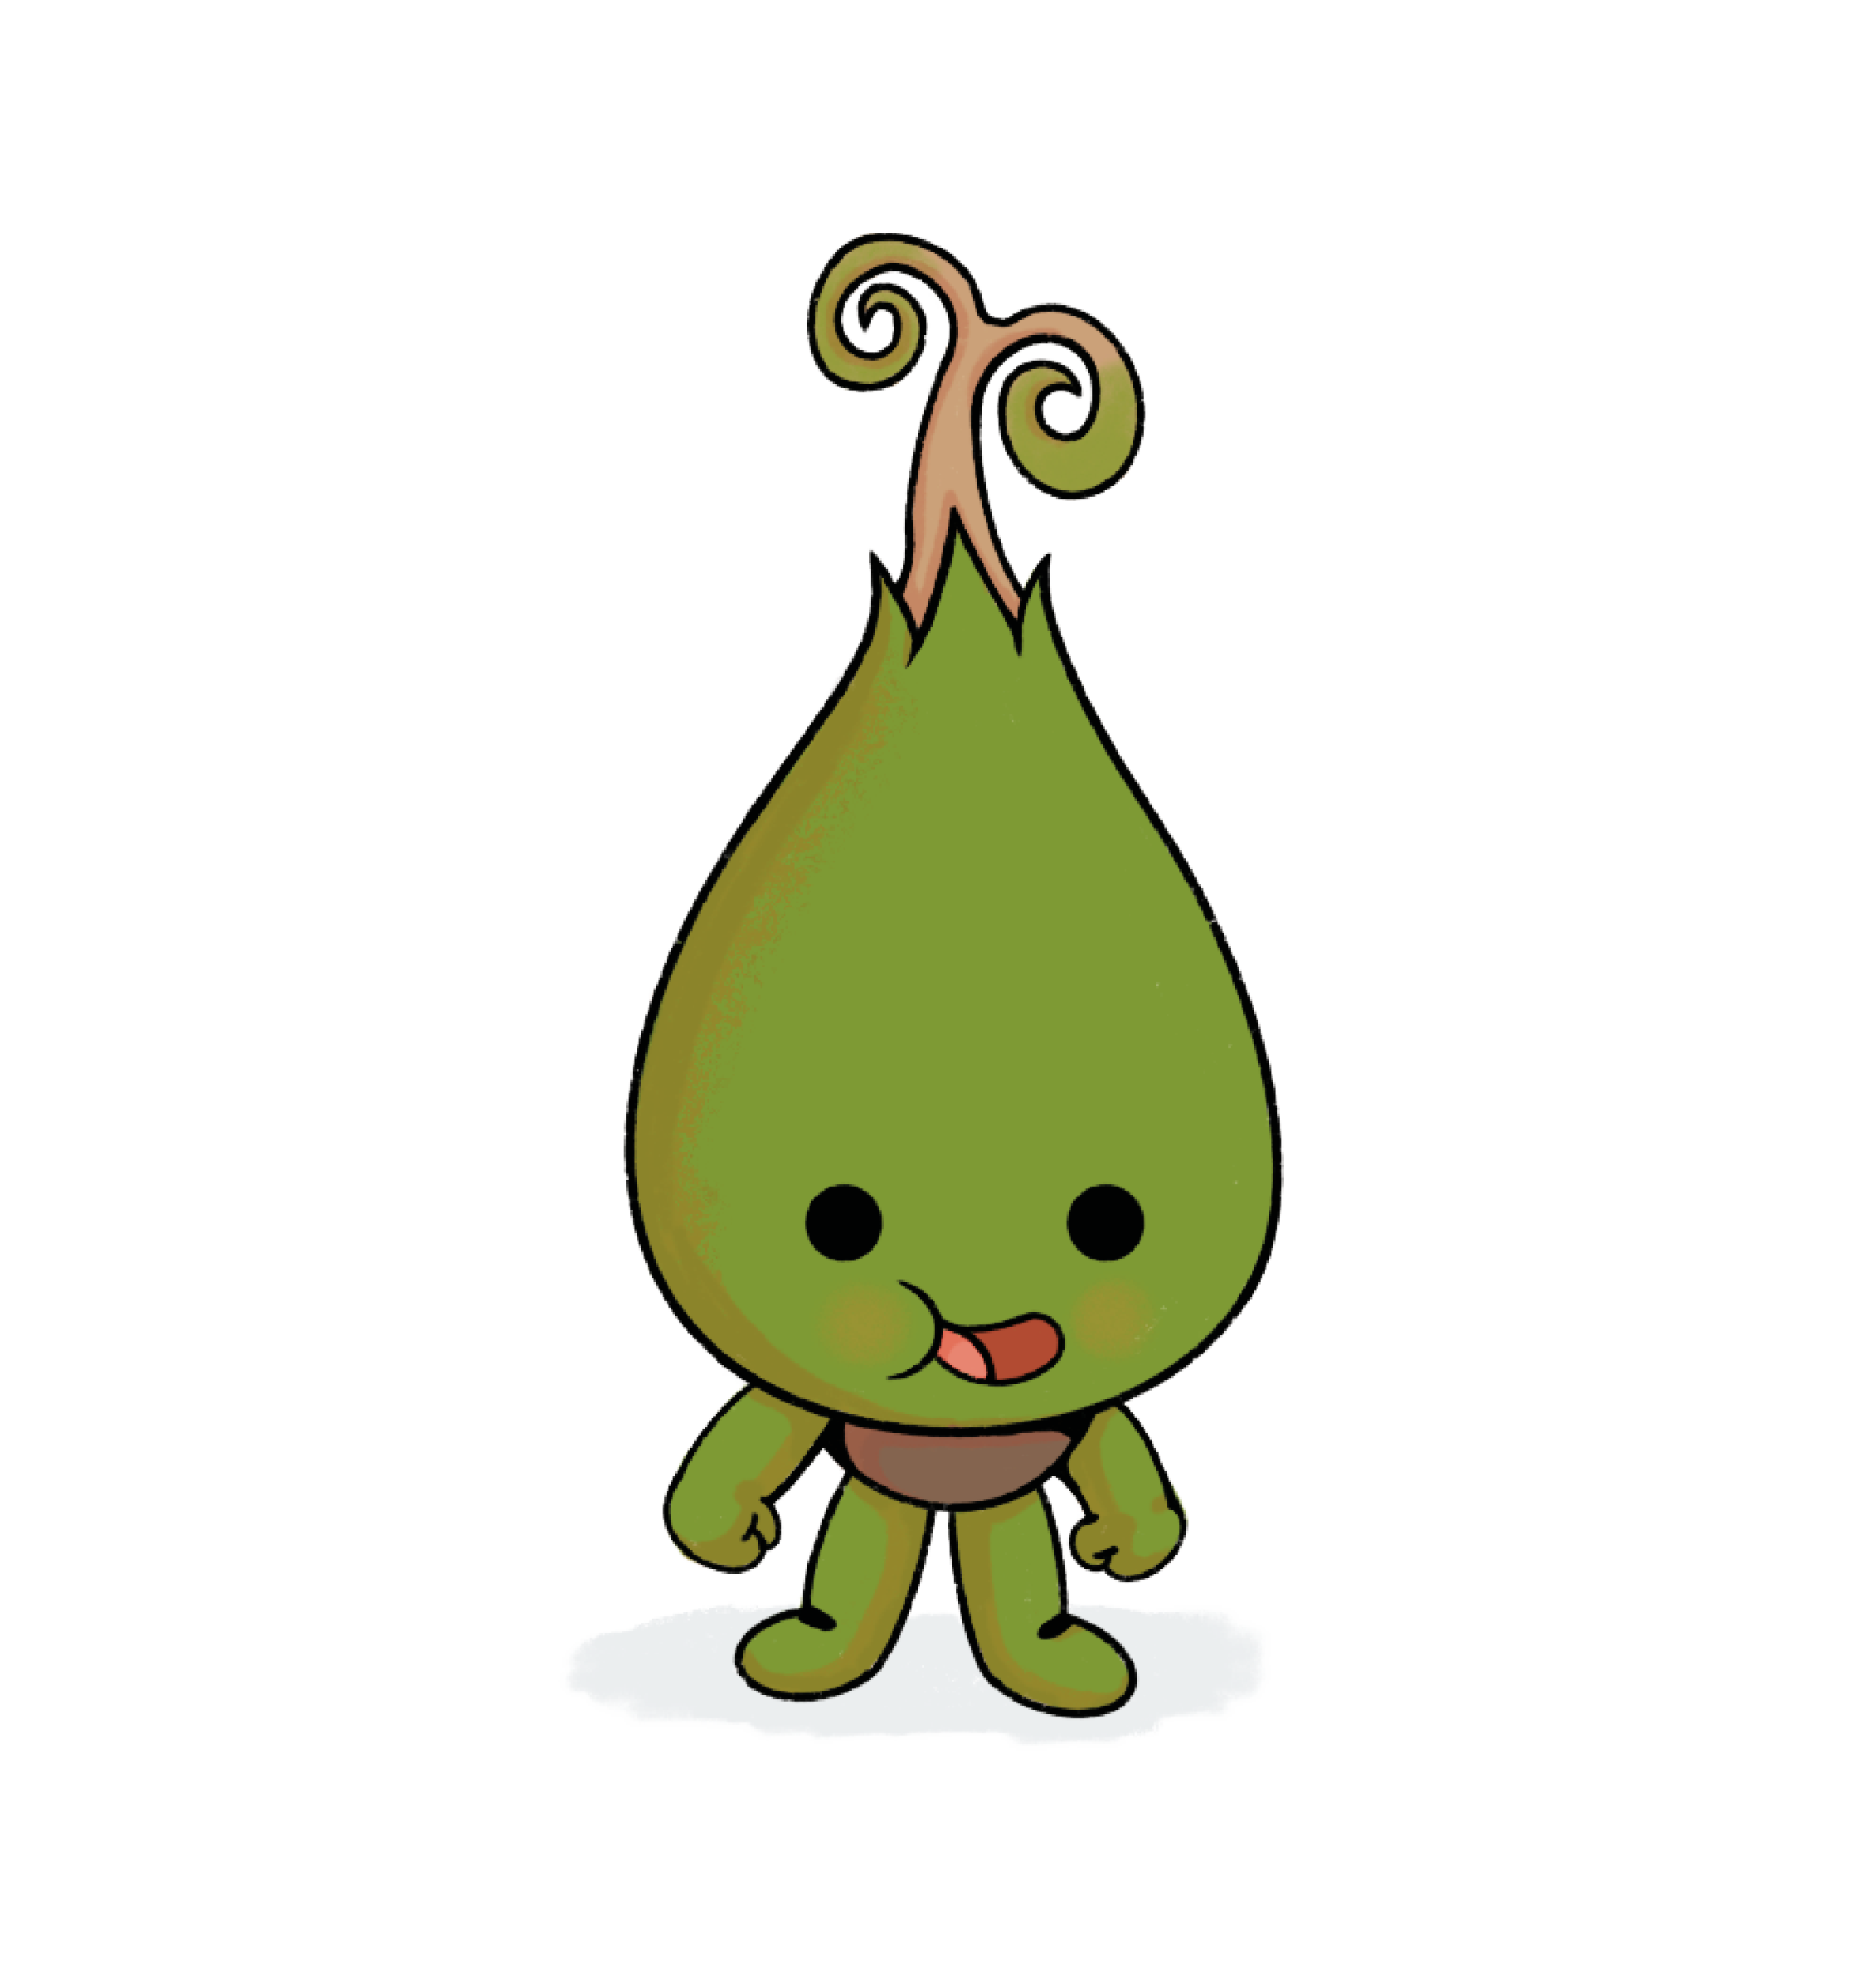
Selected Libraries will also be taking part in HAF activities. Please check with your local Community Library for more information.

Slide 11

See you at the library!

