Slide 1
House Teams

Slide 2
The House System
We use a House System across the school to promote the notion of how we operate as a TEAM at King’s Hill.
The House System upholds the values and ethos of our school and provides all of you opportunities to become involved in team events / activities and gain life skills to support you as you grow.

Slide 3
The House System
By taking part in the House System you gain attributes which reflect our school expectations:
Teamwork
Achievement
Challenge / competitiveness
Leadership
Individual / collective responsibility
Confidence
Communication Skills
Flexibility and resilience

Slide 4
House Points/Dojos
House points form part of the whole school reward system.
House points encourage a team ethos across the school and allow pupils of all ages to have a common goal.
Every pupil, from Year 1 to Year 6, are sorted into one of the four houses
You will be in the same house as your brothers and sisters

Slide 5
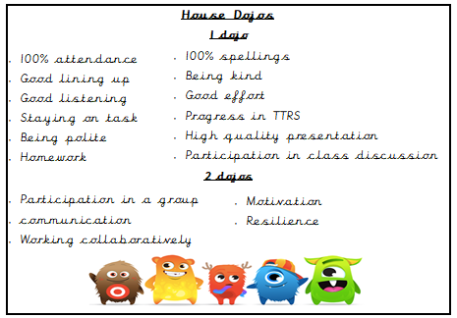

Slide 6
The Houses
AQUA – blue – Miss Hough
IGNIS – red – Mrs Kemshall
TERRA – green – Miss Roberts
VENTUS – yellow – Mrs Taheir

Slide 7


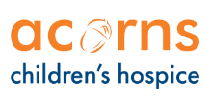





The theme for this year is Local Area Charities

Slide 8


Aqua House Charity
Walsall Healthcare Charity supports the work of Walsall Healthcare NHS Trust.
The Well Wishers is a part of the Walsall Healthcare NHS Trust and are based at Walsall Manor Hospital. Well Wishers charity supports the work of the trust by helping fund equipment and resources to help patients and their families in the Walsall area.
Some previous projects have included sensory rooms for disabled children at the Child Development Centre in Shelfield as well as in the Paediatric ward at Walsall Manor Hospital, Baby Aid appeals, Tai chi courses for MS and Parkinson's patients and a 'chill out room' for young people on the children's ward.

Slide 9
Ignis House Charity
A network of specialist nurses who care and support local children and their families.
Support for children and families inside the hospice, community and at home.
Support for siblings and other family members.
Emergency care and bereavement support.
Care is tailored for each individual child and designed to meet all their clinical, emotional, cultural and spiritual needs.
Three hospice facilities in the West Midlands, one of those is in Walsall.

Slide 10
Terra House Charity
Samaritans are a UK charity that have a branch in Walsall.
They provide support all year round for people who feel like they need someone to speak to.
They promote good mental health.

Slide 11
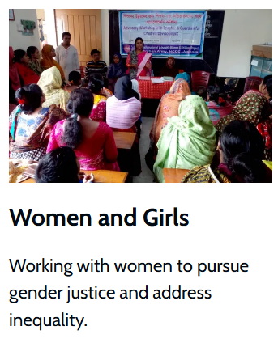
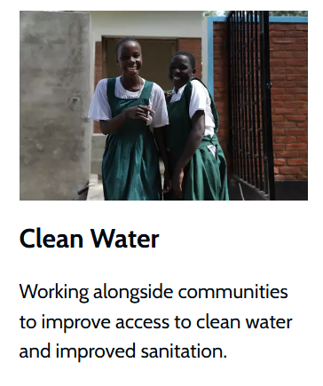
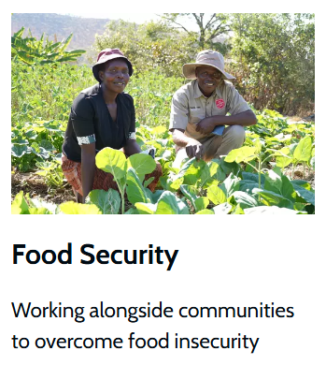
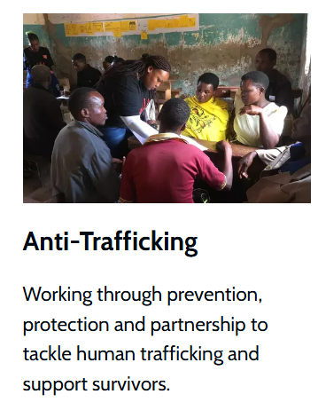

Ventus House Charity
The Salvation Army works alongside communities around the world to defeat poverty and injustice.
Their international work is divided into five themes:

Slide 12
House Captains(Y6)
House Vice Captains (Y5)
Aqua - Yaseera
Ignis - Eliyiah
Terra - Lacey-Mai
Ventus - Sahib
Aqua - David
Ignis – Mariam
Terra - Seren
Ventus - Navraj

